Slide 1
Ending Chronic homelessness In Camden county
April 5, 2024
Collingswood Grand Ballroom
Camden County

Slide 2
COMPLEXITY DEMANDS ADAPTIVE LEADERSHIP STRATEGIES (Michele Brown, United Way of Anchorage 2018)
Complexity is the New Normal
We tend to address social ills by first assigning responsibility for who should “fix” the problem and then looking for single “silver bullet” solutions. But complex problems require different management strategies and leadership.
We often assign responsibility to “fix” problems to an individual, unit of government, or social services agency. To manage complex problems, we have to recognize that change must occur simultaneously at multiple levels – the individual, the family, the community, service providers, governing bodies, etc. If we fail to recognize the need for calibrated and synchronized action across the ecosystem of these interrelated responsibilities, we will not make progress.

Slide 3
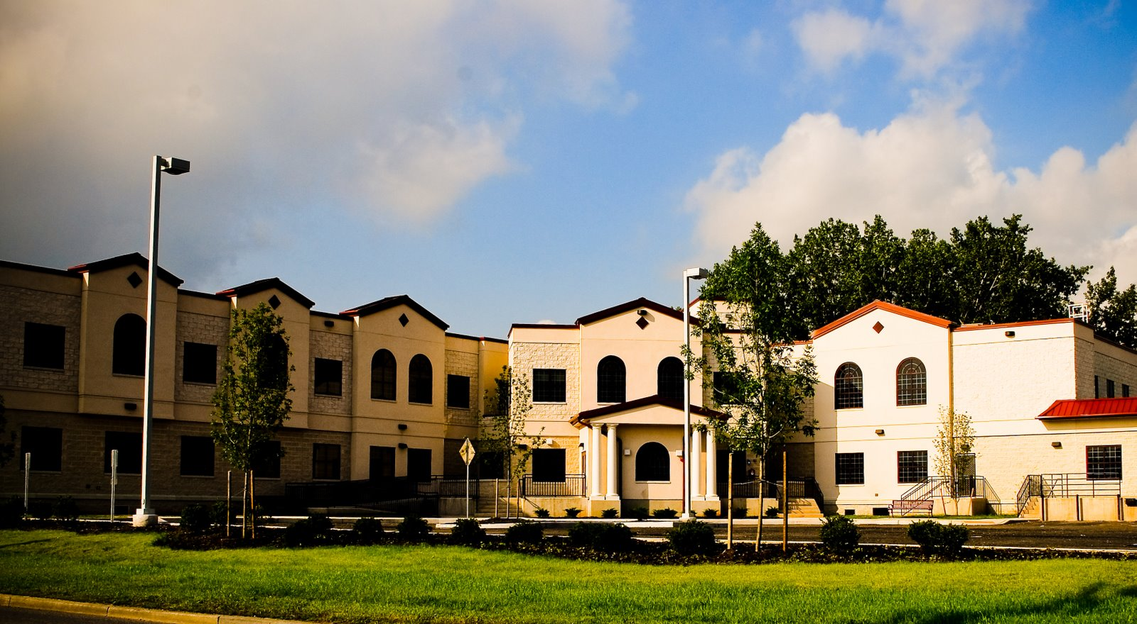
Bergen County Housing, Health, and Human Services Center
A shared project between the County of Bergen and the Housing Authority of Bergen County, with the mission to end homelessness by providing a full continuum of housing services, including homelessness prevention, temporary shelter, and permanent placement.
Notes:
Because of its mission and organizational structure, the HHH center provides a unique opportunity to nurture a culture built on collaboration, learning and shared services. The center is a focal point and single location for a broad range of services directed to people who are homeless or need assistance connecting with services needed to ensure successful reentry into society. It offers the opportunity for agencies to craft collaborations that improve the effectiveness of their efforts while reducing their cost.

Slide 4
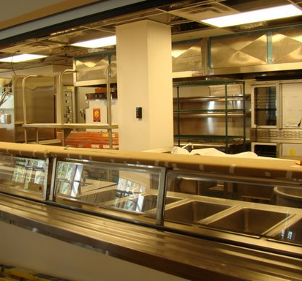
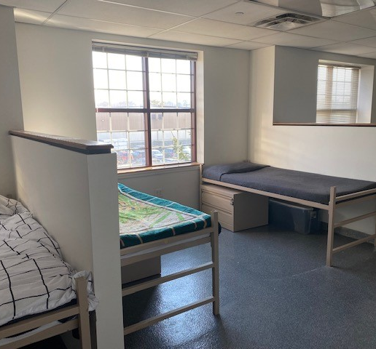
Bergen County Housing, Health & Human Services Center
90 Shelter Beds / Open 24 Hours
One Stop design with Drop-In Program 365 days a year
Nutritional Program - 3 meals a day (lunch & dinner for the Community)
Showers, laundry, storage, mail service, computers, telephones
Wellness Services (Nurse on-site)
“Command Center” Flex Office Space for Collaborative Partners:
Board of Social Services, Housing Specialist, Legal Services, Mental Health Counseling, Recovery Specialists, Vocational Services, and Case Management Services and Case Management Services
90 Shelter Beds / Open 24 Hours
One Stop design with Drop-In Program 365 days a year
Nutritional Program - 3 meals a day (lunch & dinner for the Community)
Showers, laundry, storage, mail service, computers, telephones
Wellness Services (Nurse on-site)
“Command Center” Flex Office Space for Collaborative Partners:
Board of Social Services, Housing Specialist, Legal Services, Mental Health Counseling,

Slide 5
Next Step Program-“Radical Hospitality”
Open 7 days/twice a day. Morning and afternoon available (lunch provided in between sessions and dinner following the afternoon session ).
Assertive Daytime Programming (interns onsite).
Human Services including shower, food, clothing, laundry and on-site nursing care. ID Recovery and Vocational counseling and placement available.
Referrals to mental health (counseling, outpatient and inpatient) and substance use services (MAT, detox, peer recovery, outpatient and self-help on-site).
On-site kiosk to apply for housing authority programs including rental arrears and apply to open waitlists.
Shelter applications taken, VI-SPDAT taken to add to the Coordinated Entry (CE) and Housing Prioritization List (HPL)
Daytime warming and cooling Center for the City/County
Code Blue Operations for the City/County

Slide 6
Best Practices of Low Barrier and Housing-Focused SYSTEM
Housing First
Housing-focused services
Rapid exits to permanent housing
Data-driven
Persistent, coordinated, and creative outreach
Engage and support PHA’s
Set and hold partners accountable

Slide 7
Culture of Collaboration
Because of its mission and organizational structure, the HHH Center provides a unique opportunity to nurture a culture built on collaboration, learning and shared services.
The Center is a focal point and single location for a broad range of services directed to people who are homeless or need assistance connecting with services needed to ensure successful reentry into society.
It offers the opportunity for agencies to craft collaborations that improve the effectiveness of their efforts while reducing their cost.

Slide 8
Government Leadership: County Seat, Hackensack
“The collaboration between law enforcement and service providers to address homelessness has been a great benefit to the city and keeps paying dividends. Providing mental health first aid training to police officers and assisting the library staff so they can more effectively interact with individuals experiencing mental health and substance use disorders has proven to be highly effective. Without this effective and robust approach towards addressing homelessness, Hackensack could never have revitalized.”
- John Labrosse, Mayor of Hackensack, NJ

Slide 9
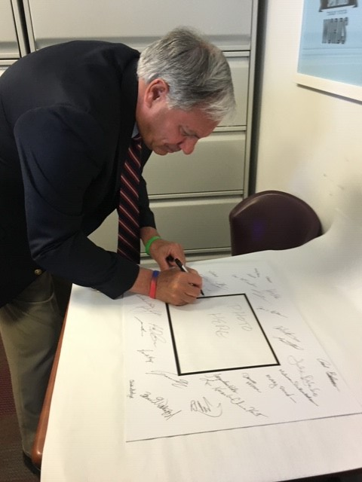
Government Leadership: Bergen County
“This achievement is the result of many dedicated people working together to support some of the most vulnerable individuals in our communities….
This was truly an effort that required all hands-on deck.
We all started with the principle that everyone deserves a home. For the chronically homeless that first step of secure, stable housing can be an incredibly difficult task.”
- County Executive James Tedesco, III
Remarks at a press conference, March 28, 2017

Slide 10
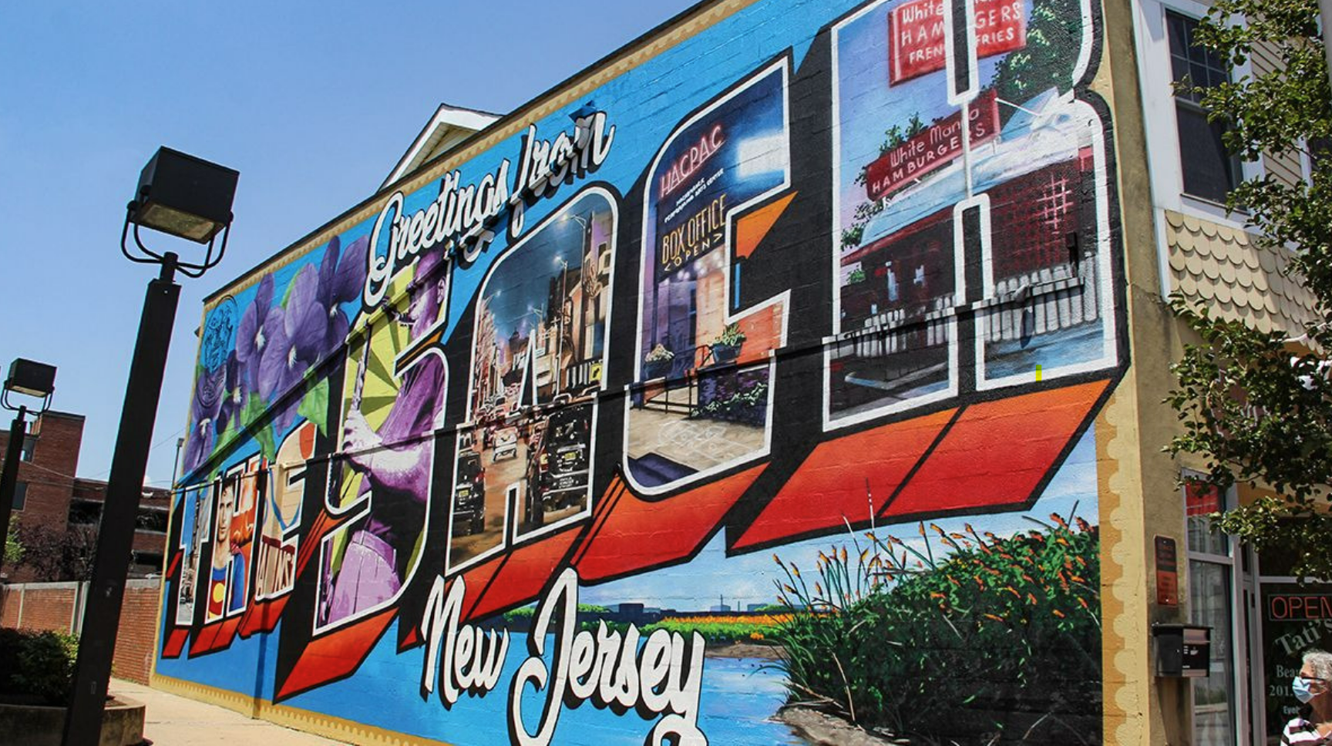
Collaborative Business Partnership
“Growing up in Bergen County means I can very much appreciate the changes made to Hackensack over the last ten years. Upon my arrival and taking my new position here, I was so pleased to see all the positive changes made. Part of my initial strategy was to meet with as many people as I could, from residents to our members to City leadership, and I have had almost 100 meetings so far. I can tell you this – you’d be hard-pressed to find someone who doesn’t credit Julia Orlando and her team at the Bergen County Housing, Health, and Human Services Center as having had a major influence in all the positive change made here in Hackensack. When I met with Julia for the first time on behalf of the MSBA, Julia quickly brought me up to speed on the programs, the processes, and the training she’d provide our members to show us how we can help find refuge and permanent housing for the homeless population of Hackensack.
We are so grateful to Julia. She’s a critical partner of ours.”
John T. Peters, Executive Director
Main Street Business Alliance
Hackensack, NJ

Slide 11
Meeting the Needs of the Client
Within the Needs of Our Community
Hackensack Collaborative Outreach – includes law enforcement, library social workers, business owners, local hospital staff, and clergy
Assist outreach into the community and business district
Concentrated outreach with municipalities needing assistance with homeless individuals
Emphasis on being a good community guest; holding people accountable for their behavior
Volunteerism – shaping community donations and volunteer opportunities into giving what people really need, instead of what people think we need….

Slide 12
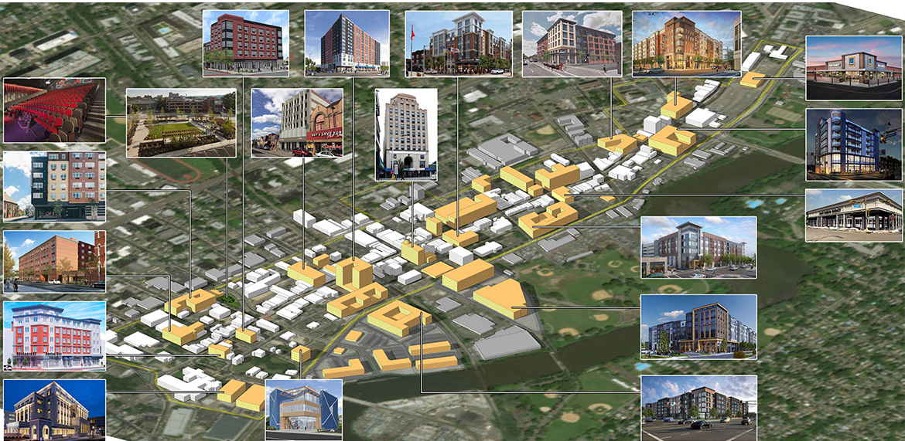
HACKENSACK REVITALIZATION

Slide 13
Getting to Zero
“Ending chronic homelessness takes political will, leadership, collaboration, and coordination among multiple state and local programs, to align resources for housing and supportive services.”
* Adapted from USICH 10 Strategies to End Chronic Homelessness

Slide 14
What’s in Our Toolbox?
Strong Continuum of Care and HSAC advocacy
Housing First system orientation, response and outreach
Homeless Prevention services and funds available
Government, non-profit and faith-based collaborative / engagement
Coordinated Assessment Tools: HPQ, VI-SPDAT, and By-Name List
Voucher set-asides and prioritization to increase housing
Monthly meetings, case conferencing, integrating additional partners
Good relationships with law enforcement, first responders, and local hospitals
Expansive community involvement, engagement, and education
Diversion, when possible
Low Barrier, Housing-Focused Shelter
Political Will

Slide 15
BERGEN’S OUTCOMES 2010-2024 Over 2000+ Individuals Placed in Permanent Housing (over 250 were Chronic) 2,000+ families / individuals in danger of losing their housing were provided prevention and/or rapid rehousing Over 400,000 individuals have made in-person or virtual visits to Next Step Over 1 million meals have been served Less than 5% Recidivism Rate Completed the Mayors Challenge to End Veteran Homelessness August 2016 (First County in New Jersey, 28th in the nation)) Reached Functional Zero for Chronic Homelessness February 2017 (First Community in the Nation to End) Reached Functional Zero for Veterans Homelessness April 2017 (double zero community) Sustaining Zero for Veteran & Chronic Homelessness for over 6 years

Slide 16
Julia Orlando, Ed.M, MA, DRCC, CRC
Contact Me/Follow Me:
Mobile: 551-804-9000
Email: juliaorlandoconsulting@gmail.com
Twitter: @JuliaOrlando4
LinkedIn: Julia (D’Angelo) Orlando
Website: www.juliaorlandoconsulting.com

Slide 17
Bergen County Government Leadership
County Executive James J. Tedesco, III
Bergen County Board of Commissioners:
Commissioner Chair Germaine M. Ortiz Commissioner
Commissioner Vice-Chairman Mary J. Amoroso
Commissioner Thomas J. Sullivan
Commissioner Chair Pro Tempore Dr. Joan M. Voss
Chairwoman Tracy S. Zur
Commissioner Rafael Marte
Commissioner Steven A. Tanelli
Lynn Bartlett, Executive Director,
Housing Authority of Bergen County, HABC

